Slide 1
Global Challenge badge
Adding interest and support, for leaders to run a balanced programme.

Slide 2
Global Challenge
Cub Scouts should complete four of the following:
Find out about the traditions, culture, food, religion and other interesting characteristics of a country different from your own.
Find out about the work of an international charity that helps around the world (for example, OXFAM, UNICEF) and then present your findings to the rest of the Pack.
Find out about an aspect of international Scouting. You could take part in a 'Join In Jamboree' activity, or arrange a visit from a Jamboree participant. Or you could find out about Scouting in a country of your choice.
Find out about things that can be recycled or how energy can be saved. Over a period of weeks show how you have recycled or saved energy at home.
Find out about a global issue such as poverty, conservation or water and sanitation, and what you can do to help.
Find out about a technology of your choice. This could be a personal computer, a car engine, an aircraft or anything similar. You should understand the basic functions of the technology and how it is used and a brief history. You should then present your findings to the rest of the Pack.

Slide 3
1 – Countries around the world. www.packresources.co.uk - Mexico
Through the whole of this website there are places where you can extend the global aspect of the programme.
Here is one such example for the country of Mexico, which my cubs looked at last term. (Thanks to Adam for some of the ideas and research.)

Slide 4
2: International Charities. Save the Children -Friendship Passport
How will Save the Children help us to deliver the Friendship Passport?
When you register on the website, we will send you a leaders’ resource pack with a colour copy of the full resource, the stickers you’ll need for the passports, balloons, and other useful aids and sources of information.
Additional downloads are also provided to help you run certain activities (there’s more information about these in the introductory pages of the resource).
If you need advice on organising any of the activities, would like to request a Save the Children speaker to visit your section, or simply wish to give us feedback on our resources or share your story, please get in touch (our contact details are given below). We’d love to hear from you.
The Volunteer Support Team Save the Children 1 St John’s Lane London EC1M 4AR Email: scouts@savethechildren.org.uk
Telephone: 020 7012 6997
http://www.savethechildren.org.uk/assets/php/scouts-register.php

Slide 5
3: International Jamborees JOTA, JOTI or Jamboree participant
You could join JOTA / JOTI around the middle of October each year.
You could ask a Jamboree participant to come and talk to your cubs about their experience.
You could look at where the Jamboree is going to held next and look at scouting there. Japan 2015, where theme will be “Spirit of Unity”.

Slide 6
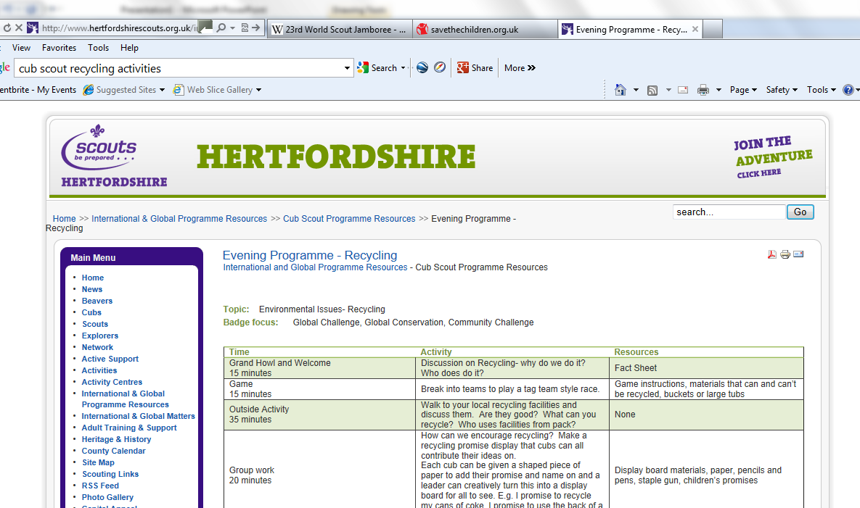
4: Recycling and Energy Saving Encouraging the cubs

Slide 7
5: Global Issues
This is covered by the Save the Children really well.

Slide 8
6: Technology of Choice
This is great one for research if you pack has access to the internet.
Links with other badges, such as IT staged badge or air activities badge.

Slide 9
Websites which might be helpful
http://www.savethechildren.org.uk/assets/php/scouts-register.php
http://www.wateraid.org/uk/learn_zone/teachers/primary/default.asp
www.packresources.co.uk
www.hertfordshirescouts.org.uk/index.php/international-and-global-resources/118-cub-scout-programme-resources

